Slide 1
Implementation of 32-Bit 5-Stage RISC Processor using Verilog
Submitted to:
Dr. Prasanna Kumar Mishra
Assistant Professor,
Department of Electronics and Communication Engineering,
Indian Institute of Information Technology- Allahabad,
Uttar Pradesh 211 102, India.
Email: prasanna@iiita.ac.in
Presented By:
Ankit B Parashar
MEC2019024
Department of Electronics and Communication Engineering,
Indian Institute of Information Technology- Allahabad,
Email: mec2019024@iiita.ac.in

Slide 2
Implementation of 32-Bit 5-Stage RISC Processor using Verilog
Work outline:
Introduction
Instruction Set Architecture
32-Bit Non-Pipelined RISC Processor
32-Bit Pipelined RISC Processor

Slide 3
Implementation of 32-Bit 5-Stage RISC Processor using Verilog
INTRODUCTION
MIPS (Microprocessor without Interlocked Pipelined Stages) is a Reduced Instruction Set Computer (RISC) Instruction Set Architecture (ISA) developed by MIPS Computer Systems.
A Basic MIPS Implementation:
We will be examining an implementation that includes a subset of the core MIPS instruction set:
The memory-reference instructions load word (LW) and store word (SW).
The arithmetic-logical instructions( ADD, SUB, ADDI, SUBI, AND, OR, MUL, MULI, SLT and SLTI).
The instructions branch equal (BEQZ, BENQZ) and jump (J), which we add last.
The Instruction Execution Cycle is divided into 5 steps:
Instruction Fetch (IF)
Instruction Decode (ID)
Execution (EX)
Memory Access (MEM)
Register Write-Back (WB)

Slide 4
INSTRUCTION SET ARCHITECTURE
R- Type (for register type instruction. ex. Add rd, rs, rt.
OPCODE | SOURCE REG1 | SOURCE REG2 | DESTINATION REG | SHIFT AMOUNT | FUNCTION
31-26 | 25-21 | 20-16 | 15-11 | 10-6 | 5-0
I- Type (for immediate type instructions. Ex. AddI rd, rs, #16bit data.
OPCODE | SOURCE REG | DESTINATION REG | IMMEDIATE
31-26 | 25-21 | 20-16 | 15-0
J-Type (for jump type instructions)
OPCODE | TARGET
31-26 | 25-0

Slide 5
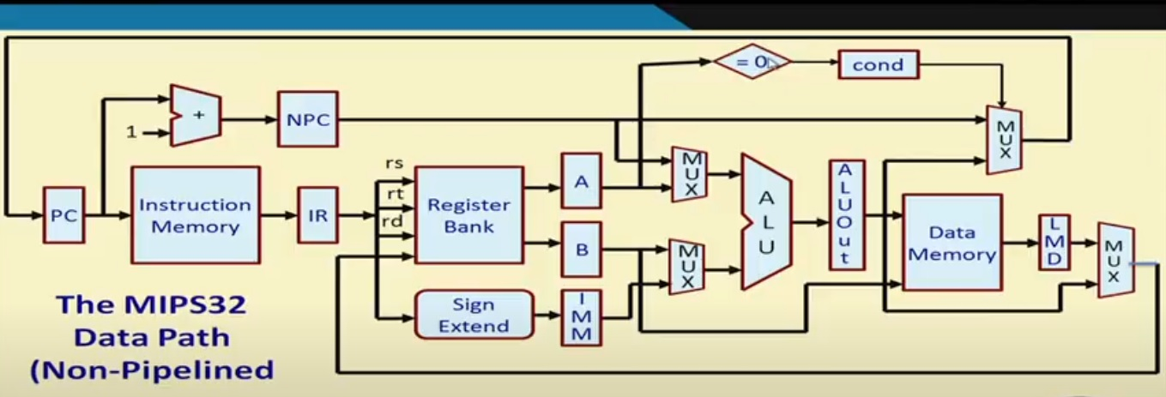
Implementation of 32-Bit 5-Stage RISC Processor using Verilog
32-Bit Non-Pipelined RISC Processor
Architecture:

Slide 6
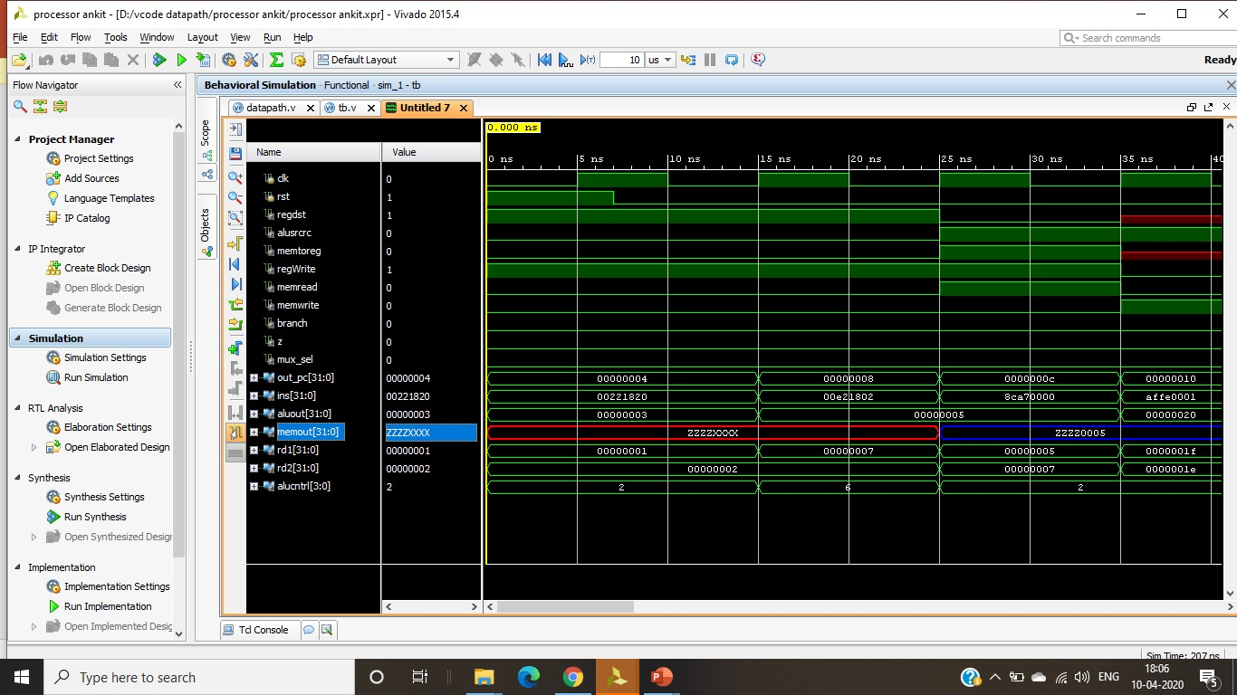
Implementation of 32-Bit 5-Stage RISC Processor using Verilog
32-Bit Non-Pipelined RISC Processor
Simulation Result:

Slide 7
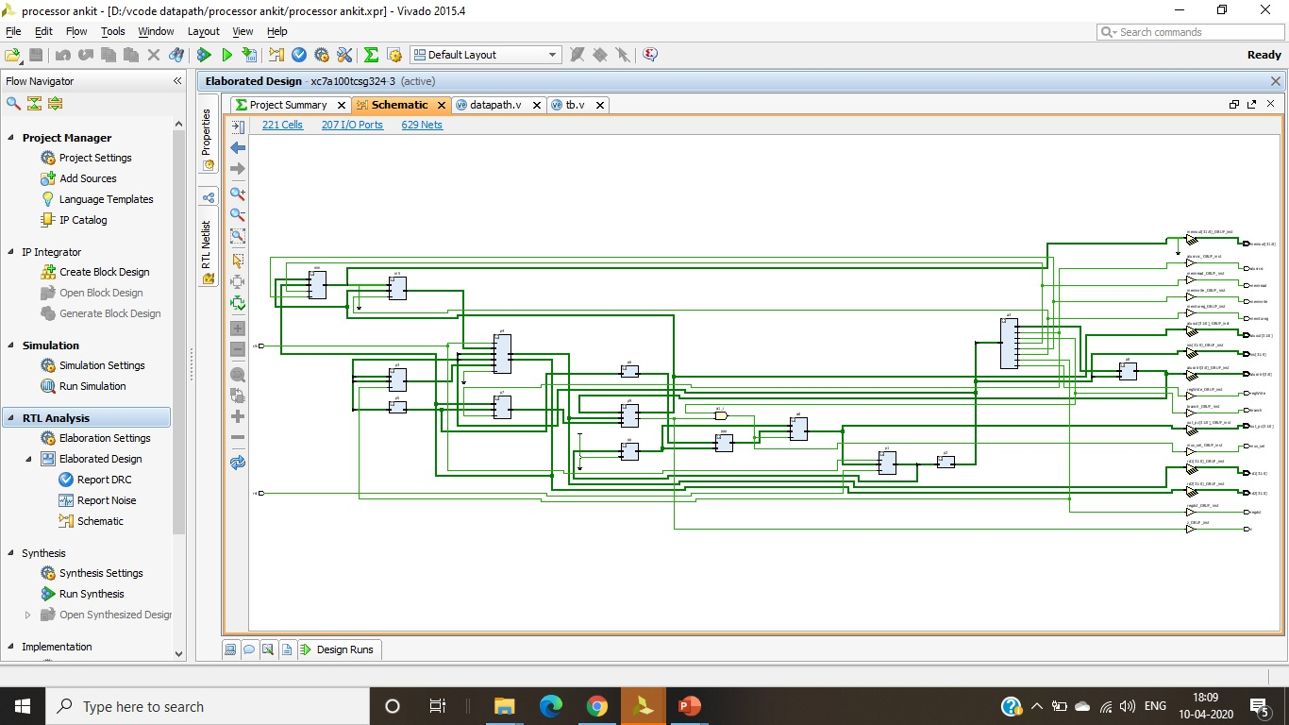
Implementation of 32-Bit 5-Stage RISC Processor using Verilog
32-Bit Non-Pipelined RISC Processor
RTL Schematic :

Slide 8
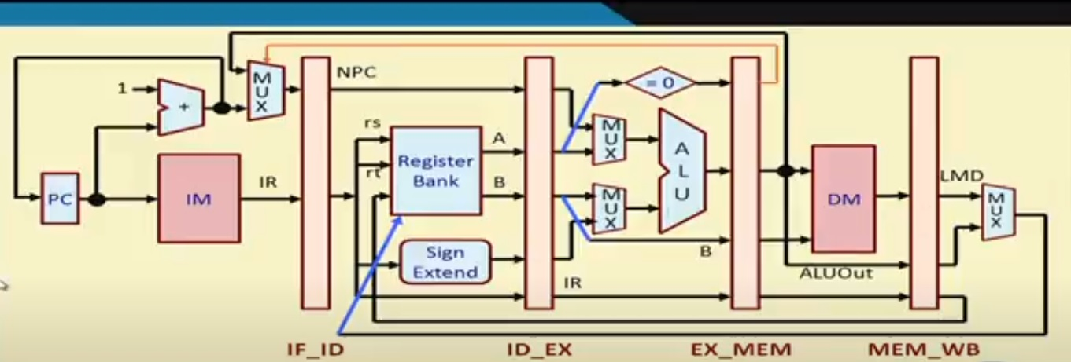
Implementation of 32-Bit 5-Stage RISC Processor using Verilog
32-Bit Pipelined RISC Processor
Architecture:

Slide 9
Implementation of 32-Bit 5-Stage RISC Processor using Verilog
32-Bit Pipelined RISC Processor
For Executing This Instructions:
ADDI R1,R0,10;
ADDI R2,R0,20;
ADDI R3,R0,25;
ADD R4,R1,R2;
ADD R5,R4,R3;
HLT
Test Bench is as follow:
module TEST_PIPELINE();
reg CLK1, CLK2;
wire [31:0] PC, IF_ID_IR, IF_ID_NPC, ID_EX_IR,
ID_EX_NPC, ID_EX_A, ID_EX_B, ID_EX_Imm, EX_MEM_IR, EX_MEM_ALUOut, EX_MEM_B,MEM_WB_IR, MEM_WB_ALUOut, MEM_WB_LMD;
wire [2:0] ID_EX_type,EX_MEM_type,MEM_WB_type;
integer k;
PIPELINE_PRO mips(CLK1, CLK2, PC, IF_ID_IR, IF_ID_NPC, ID_EX_IR,
ID_EX_NPC, ID_EX_A, ID_EX_B, ID_EX_Imm, EX_MEM_IR, EX_MEM_ALUOut, EX_MEM_B,MEM_WB_IR, MEM_WB_ALUOut, MEM_WB_LMD,ID_EX_type, EX_MEM_type, MEM_WB_type);
initial
begin
CLK1= 0; CLK2=0;
repeat(20)
begin
#5 CLK1=1; #5 CLK1=0;
#5 CLK2=1; #5 CLK2=0;
end
end
initial
begin
for(k=0; k<31; k=k+1)
mips.Reg[k] = k;
mips.Mem[0] = 32'h2801_000A; // ADDI R1, R0, 10;
mips.Mem[1] = 32'h2802_0014; // ADDI R2, R0, 20;
mips.Mem[2] = 32'h2803_0019; //ADDI R3,R0,25;
mips.Mem[3] = 32'h0CE7_7800;
mips.Mem[4] = 32'h0CE7_7800;
mips.Mem[5] = 32'h0022_2000; //ADD R4,R1,R2;
mips.Mem[6] = 32'h0CE7_7800;
mips.Mem[7] = 32'h0083_2800; //ADD R5,R4,R3;
mips.Mem[8] = 32'hFC00_0000; //HLT;
mips.HALTED = 0;
mips.PC = 0;
mips.TAKEN_BRANCH = 0;
#280
for(k=0; k<6; k=k+1)
$display("R%1d - %2d ", k, mips.Reg[k]);
end
endmodule

Slide 10
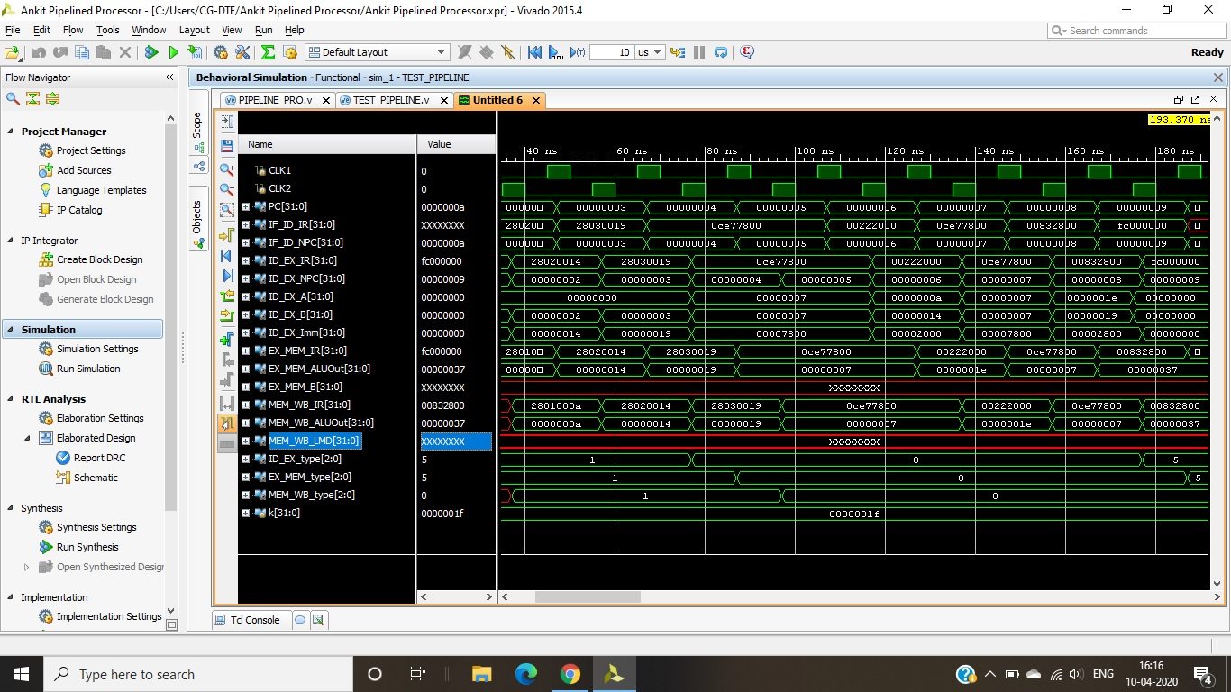
Implementation of 32-Bit 5-Stage RISC Processor using Verilog
32-Bit Pipelined RISC Processor
Simulation Result:

Slide 11
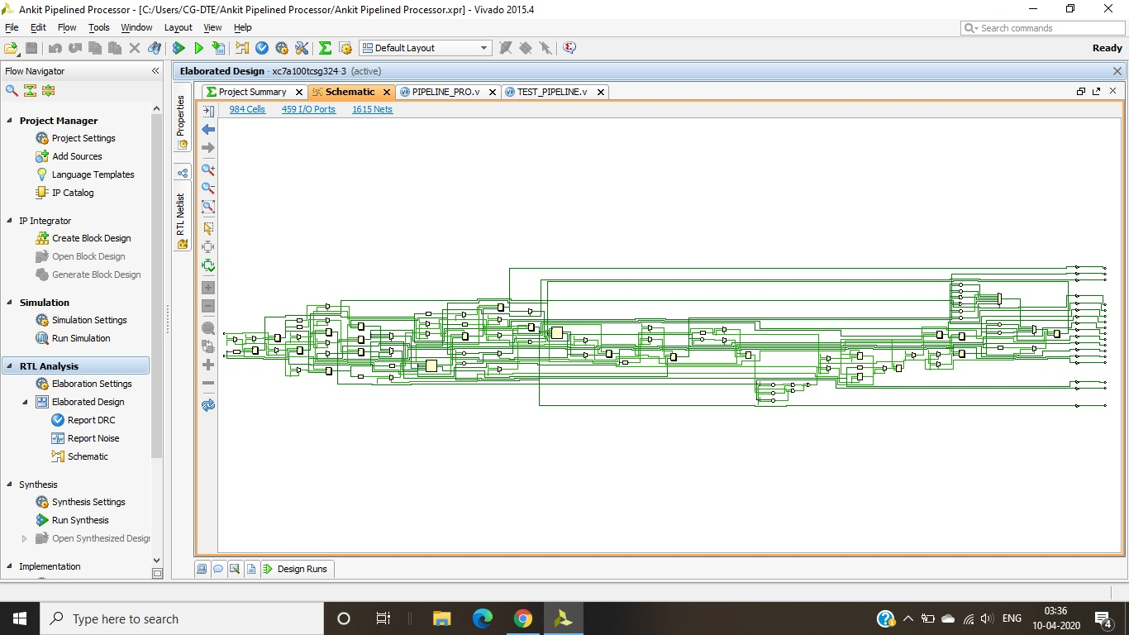
Implementation of 32-Bit 5-Stage RISC Processor using Verilog
32-Bit Pipelined RISC Processor
RTL Schematic:

Slide 12
Implementation of 32-Bit 5-Stage RISC Processor using Verilog
Thank You

